Slide 1
Queues

Slide 2
Introduction to Queues
A queue is a waiting line – seen in daily life
A line of people waiting for a bank teller
A line of cars at a toll both
What other kinds of queues can you think of
The queue has a front and a rear.
$ $
Rear
Front

Slide 3
In Queue
Items can be removed only at the front
Items can be added only at the other end, the back
1 2 3
Original Queue
Front Rear
Add 4 to the Queue
1 2 3 4
Front Rear
2 3 4
Remove the element
from the Queue
Front Rear

Slide 4
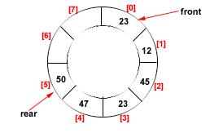
Types Of Queues
Linear Queue
Circular Queue
Double Ended Queue (Deque)
Priority Queue

Slide 5
Double Ended Queue
Double ended queues, called deques for short, are a generalized form of the queue. It is exactly like a queue except that elements can be added to or removed from the head or the tail.
However, no element can be added and deleted from the middle.
In the computer’s memory, a deque is implemented using either a circular array or a circular doubly linked list.
In a deque, two pointers are maintained, LEFT and RIGHT, which point to either end of the deque. The elements in a deque extend from the LEFT end to the RIGHT end and since it is circular, Dequeue[N–1] is followed by Dequeue[0].

Slide 6
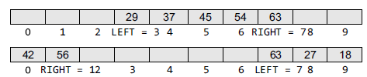
There are two variants of a double-ended queue. They include :
Input restricted deque In this, insertions can be done only at one of the ends, while deletions can be done from both ends.
Output restricted deque In this deletions can be done only at one of the ends, while insertions can be done on both ends.

Slide 7
Priority Queues
A priority queue is a data structure in which each element is assigned a priority. The priority of the element will be used to determine the order in which the elements will be processed.
The general rules of processing the elements of a priority queue are
An element with higher priority is processed before an element with a lower priority.
Two elements with the same priority are processed on a first-come-first-served (FCFS) basis.

Slide 8
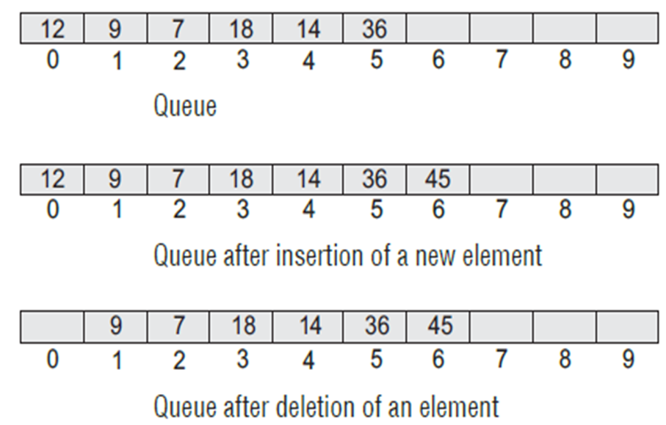
The Queue As an ADT
A queue is a sequence of data elements
Basic operations
Enqueue (add element to back)
Dequeue (remove element from front)
Enqueue & Dequeue operations

Slide 9
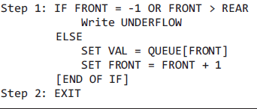
Array Implementation -Dequeue
When an item is taken from the queue, it always comes from the front.
This a dequeue operation.

Slide 10
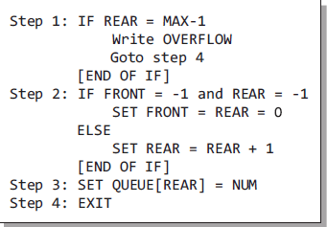
Array Implementation -Enqueue
When an item is inserted into the queue, it always goes at the end (rear).
This a enqueue operation.

Slide 11
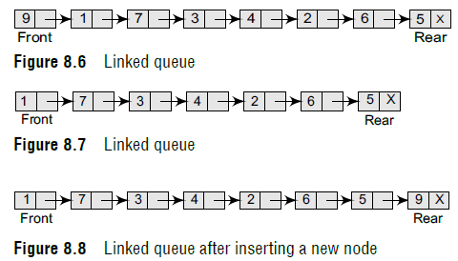
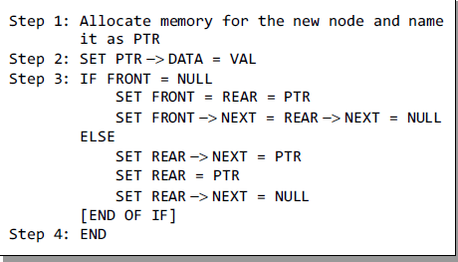
LINKED REPRESENTATION OF QUEUEs
Enqueue:

Slide 12
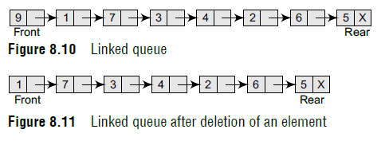
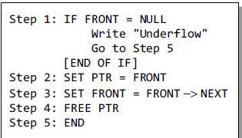
Dequeue

Slide 13
Circular Queue

Slide 14
Drawback of Linear Queue
Once the queue is full, even though few elements from the front are deleted and
some occupied space is relieved, it is not possible to add anymore new elements,
as the rear has already reached the Queue’s rear most position.
Circular Queue
This queue is not linear but circular.
Its structure can be like the following figure:
In circular queue, once the Queue is full the
"First" index of the Queue becomes the
"Rear" most index, if and only if the "Front" element has moved forward. otherwise it will be a "Queue overflow" state.
Figure: Circular Queue having
Rear = 5 and Front = 0
09/10/08
14

Slide 15
Algorithms for Insert Operations in Circular Queue
For Insert Operation
Insert-Circular-Q(CQueue, Rear, Front, N, Item)
Here, CQueue is a circular queue.
Rear represents the location in which the data element is to be inserted and
Front represents the location from which the data element is to be removed.
N is the maximum size of CQueue and
Item is the new item to be added.
Initailly Rear = -1 and Front = -1.
1. If Front = -1 and Rear = -1 then Set Front :=0 and go to step 4.
2. If Front =0 and Rear = N-1 or Front = Rear + 1
then Print: “Circular Queue Overflow” and Return.
3. If Rear = N -1 then Set Rear := 0 and go to step 4.
4. Set CQueue [Rear] := Item. and Rear:=Rear + 1
5. Return
09/10/08
15

Slide 16
For Delete Operation
Delete-Circular-Q(CQueue, Front, Rear, Item)
CQueue is the place where data are stored.
Rear represents the location in which the data element is to be inserted and
Front represents the location from which the data element is to be removed. Front element is assigned to Item.
Initially, Front = -1.
*..Delete without Insertion
If Front = -1 then Print: “Circular Queue Underflow” and Return.
Set Item := CQueue [Front]
3. If Front = N – 1 then Set Front = 0 and Return.
4. If Front = Rear then Set Front = Rear = -1 and Return.
5. Set Front := Front + 1
6. Return.
09/10/08
16

Slide 17
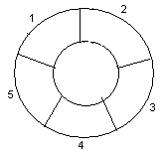
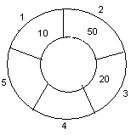
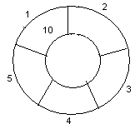
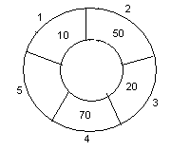
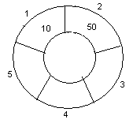
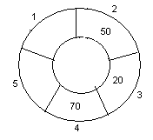
Initailly Rear = -1 and Front = -1.
1. If Front = -1 and Rear = -1 then Set Front :=0 and go to step 4.
2. If Front =0 and Rear = N-1 or Front = Rear + 1
then Print: “Circular Queue Overflow” and Return.
3. If Rear = N -1 then Set Rear := 0 and go to step 4.
4. Set CQueue [Rear] := Item. and Rear:=Rear + 1
5. Return
Example- ENQUEUE
Circular queue with N = 5.
1. Initially, Rear = 0, Front = 0.
4. Insert 20, Rear = 3, Front = 0.
Front
Rear
Rear
2. Insert 10, Rear = 1, Front = 1.
5. Insert 70, Rear = 4, Front = 1.
Front
Front
Rear
3. Insert 50, Rear = 2, Front = 1.
6. Delete front, Rear = 4, Front = 2.
Front
Rear
Front
09/10/08
17
Rear

Slide 18
Initailly Rear = -1 and Front = -1.
1. If Front = -1 and Rear = -1 then Set Front :=0 and go to step 4.
2. If Front =0 and Rear = N-1 or Front = Rear + 1
then Print: “Circular Queue Overflow” and Return.
3. If Rear = N -1 then Set Rear := 0 and go to step 4.
4. Set CQueue [Rear] := Item. and Rear:=Rear + 1
5. Return
Example- ENQUEUE
Circular queue with N = 5.
1. Initially, Rear = -1, Front =-1
4. Insert 20, Rear = 2, Front = 0.
Front
Rear
Rear
2. Insert 10, Rear = 0, Front = 0.
5. Insert 70, Rear = 3, Front = 0.
Front
Front
Rear
3. Insert 50, Rear = 1, Front = 0.
6. Delete front, Rear = 3, Front =1.
Front
Rear
Front
09/10/08
18
Rear

Slide 19
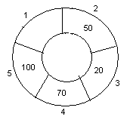
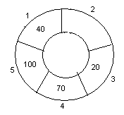
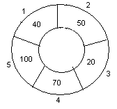
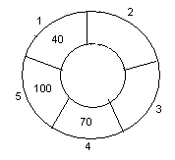
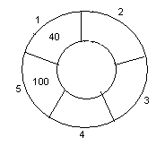
Initially, Front = -1.
If Front = -1 then Print: “Circular Queue Underflow” and Return.
Set Item := CQueue [Front]
3. If Front = N – 1 then Set Front = 0 and Return.
4. If Front = Rear then Set Front = Rear = -1 and Return.
5. Set Front := Front + 1
6. Return.
Initailly Rear = -1 and Front = -1.
1. If Front = -1 and Rear = -1 then Set Front :=0 and go to step 4.
2. If Front =0 and Rear = N-1 or Front = Rear + 1
then Print: “Circular Queue Overflow” and Return.
3. If Rear = N -1 then Set Rear := 0 and go to step 4.
4. Set CQueue [Rear] := Item. and Rear:=Rear + 1
5. Return
7. Insert 100, Rear = 4, Front = 1.
10. Delete front, Rear = 0, Front = 2.
Front
Rear
ENQUEUE/DEQUEUE
Circular queue with N = 5.
Front
Rear
8. Insert 40, Rear = 0, Front = 1.
11. Delete front, Rear = 0, Front = 3.
Rear
Rear
Front
Front
9. Insert 140, Rear = 0, Front = 1.
As Front = Rear + 1, so Queue overflow.
12. Delete front, Rear = 0, Front = 4.
Rear
Rear
Front
Front
09/10/08
19

Slide 20
Double Ended Queue
Double ended queues, called deques for short, are a generalized form of the queue. It is exactly like a queue except that elements can be added to or removed from the head or the tail.
However, no element can be added and deleted from the middle.
In the computer’s memory, a deque is implemented using either a circular array or a circular doubly linked list.
In a deque, two pointers are maintained, LEFT and RIGHT, which point to either end of the deque. The elements in a deque extend from the LEFT end to the RIGHT end and since it is circular, Dequeue[N–1] is followed by Dequeue[0].

Slide 21
There are two variants of a double-ended queue. They include :
Input restricted deque In this, insertions can be done only at one of the ends, while deletions can be done from both ends.
Output restricted deque In this deletions can be done only at one of the ends, while insertions can be done on both ends.

Slide 22
Priority Queues
A priority queue is a data structure in which each element is assigned a priority. The priority of the element will be used to determine the order in which the elements will be processed.
The general rules of processing the elements of a priority queue are
An element with higher priority is processed before an element with a lower priority.
Two elements with the same priority are processed on a first-come-first-served (FCFS) basis.

